Slide 1
2nd Annual VIMS Datathon Competition 2021
Ferdowsi University of Mashhad (FUM) Mashhad, Iran
September 2021

Slide 2
Objectives
Train Machine Learning Algorithm
Automatic Detection

Slide 3
Approach
Getting to know data
Visualize Data
Model Selection
Manual Labeling
Training Model
Model Performance
Proposed Ideas

Slide 4
Get to Know Data
Pointcloud data
Each record has 7 numerical attributes:
3 float numerical format for XYZ coordinates
1 integer for intensity
3 integers for “Red”, “Green”, “Blue” (range 0-255)
No Nan-field detected.
X | Y | Z | i | R | G | B

Slide 5
Visualize Data
CloudCompare V. 2.11.1 Application used for visualization

Slide 6
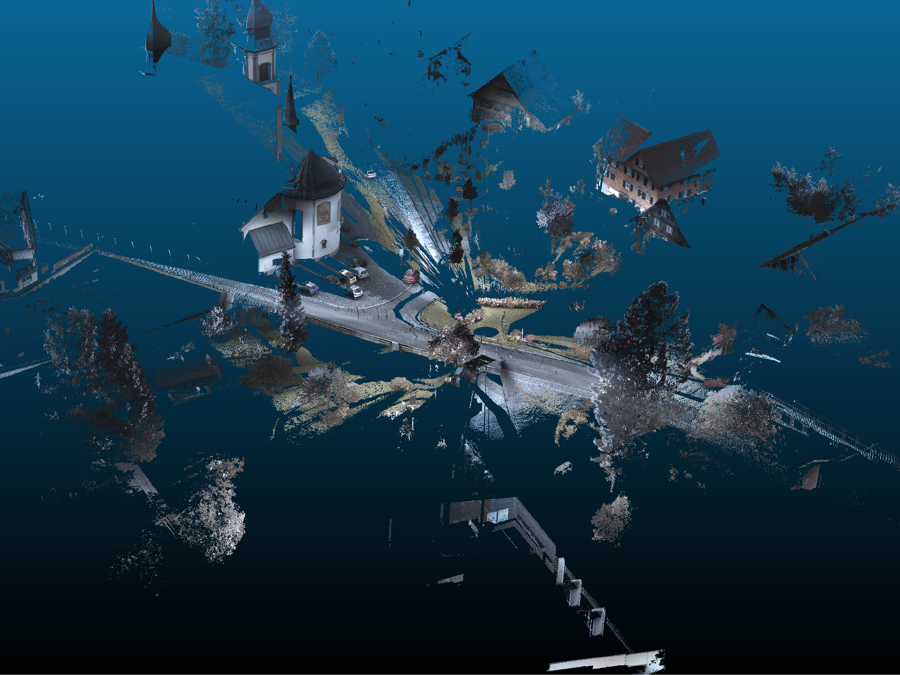

Slide 7
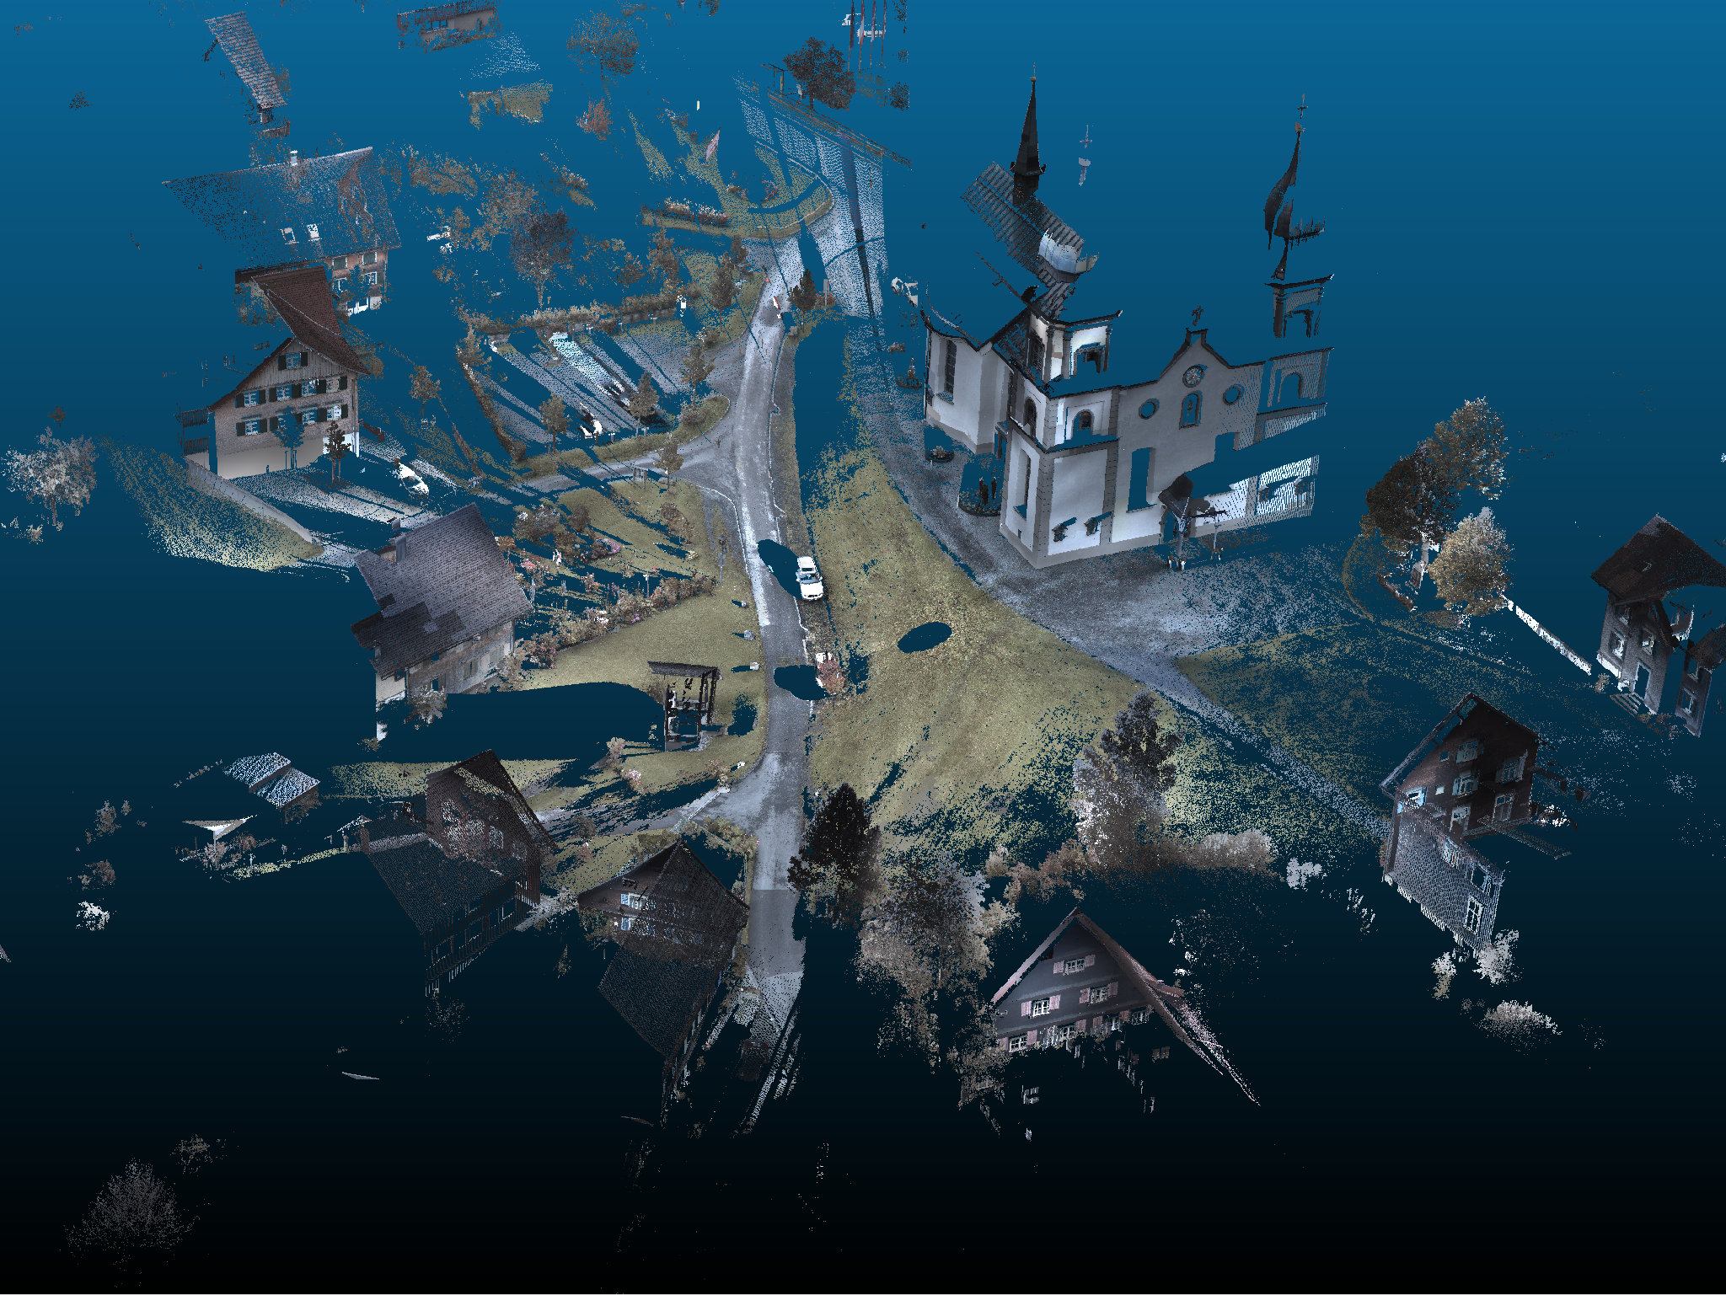

Slide 8
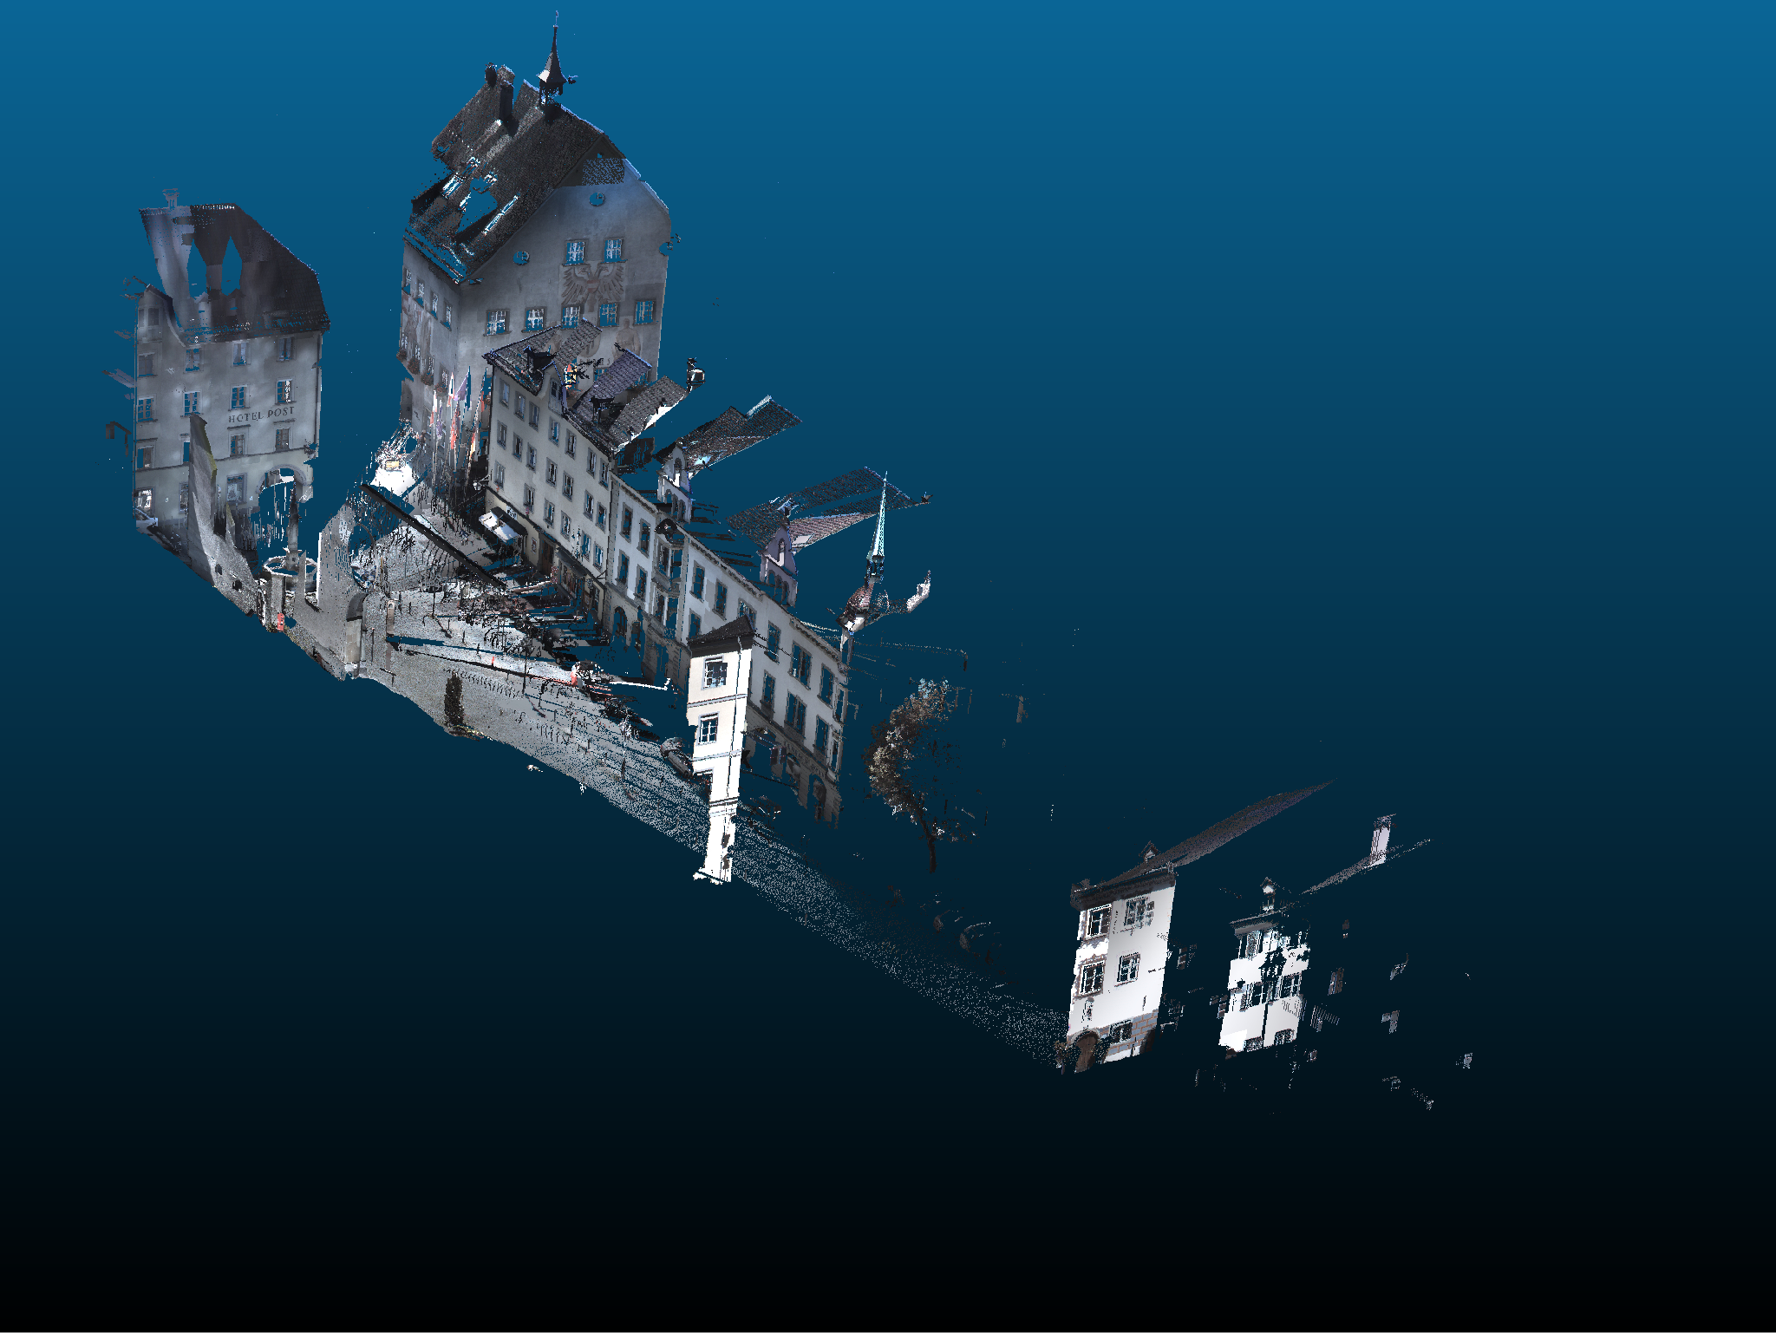

Slide 9
Model Selection
Assessed Models:
PointNet
PointRCNN
RandLA-Net

Slide 10
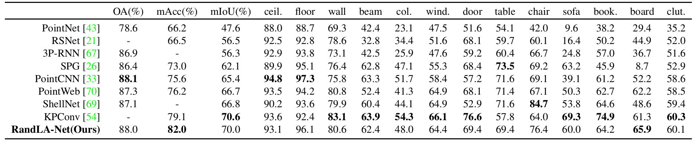
Model Selection
Better Accuracy rate
Better mIOU

Slide 11
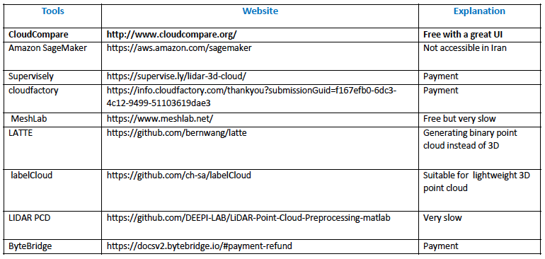
Manual Labeling
Tool Selection

Slide 12
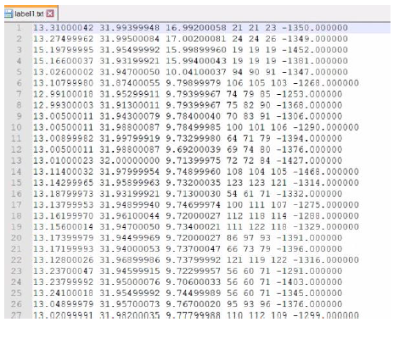
Manual Labeling
Output: TXT file format

Slide 13
Manual Labeling
Scene-1
Area-1
Scene-2
Labeling
Area-2
Scene-26
Area-3
Scene-6
Area-4

Slide 14
Training Model
S3DIS Dataset format comprises of 6-column point cloud consisted of XYZ and RGB
S3DIS Dataset Format
RandLA-NET Model
Input Data Format

Slide 15
Training Model
“intensity” feature removed from dataset
S3DIS Dataset format comprises of 6-column point cloud consisted of XYZ and RGB
Data Preparation
S3DIS Dataset Format
RandLA-NET Model
Input Data Format

Slide 16
Training Model
S3DIS Dataset
Scene-1
Area-1
Scene-2
Labeling
Area-2
RandLA-NET Model
Scene-26
Area-3
Scene-6
Area-4
Scene-1
Duplicated
Area-5
Scene-2
Area-6

Slide 17
Model Performance
IoUClass1: 16.23
IoUClass2: 36.18
IoUClass3: 2.67
IoUClass4: 30.65
Mean IoU: 21.43

Slide 18
Proposed Ideas
for
Future Research

Slide 19
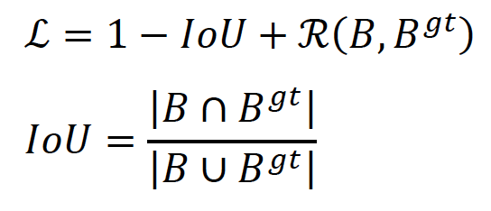
Proposed Ideas (1)
CIoU vs. IoU
CIoU has better convergence rate in comparison to IoU
Generally, the IoU-based loss is defined as (Zheng et al., 2020):

Slide 20
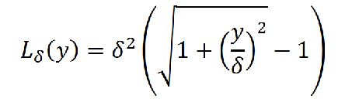
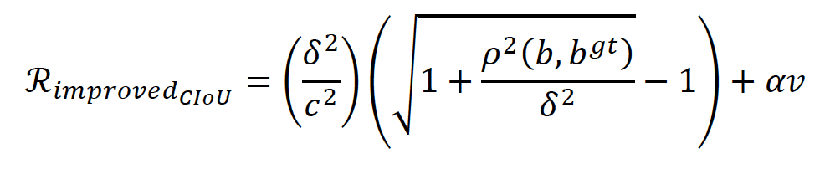
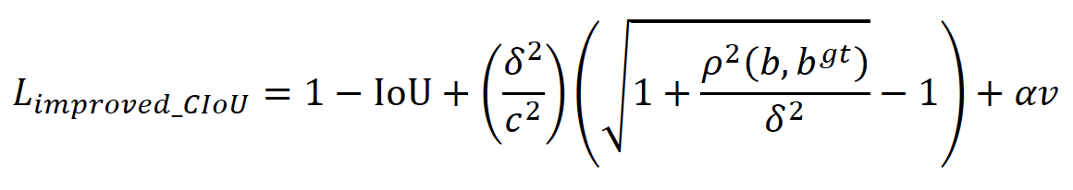
Proposed Ideas (1)
CIoU vs. IoU
The proposed approach applied an improved on CIoU based on Pseuso-Huber loss (Barron et al.,2019). Pseuso-Huber loss used in robust regression. It can be defined:
Where y is difference between the target and predicted values and δ is an adjustable parameter. In this way, the penalty operates like squared error loss when the error is within [-δ,δ] but becomes linear outside this range (Barron et al., 2019). Therefore, we improved CIoU loss by replacing Pseudo-Huber formula instead of Euclidean distance:
Finally, the proposed loss function can be written as:

Slide 21
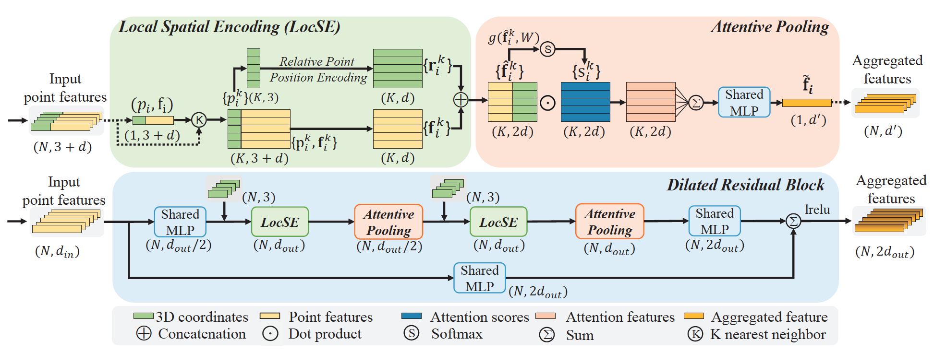
Proposed Ideas (2)
Optimize Model (Heuristics)

Slide 22
Proposed Ideas (2)
Optimize Model (Heuristics)
For Local Spatial Encoding (LocSE) Unit:
Define L-levels of neighbourhood
Select K/L neighbours form each level
Each level is K^L of nearest neighbour
It is expected that this heuristic method will leader to better segmentation performance of the mode.

Slide 23
Thank you

